Slide 1
Teaching
Slide Set
Global Strategy for the Diagnosis, Management, and Prevention of
Chronic Obstructive Pulmonary Disease
This slide set is restricted for academic and educational purposes only. Use of the slide set, or of individual slides, for commercial or promotional purposes requires approval from GOLD.

Slide 2
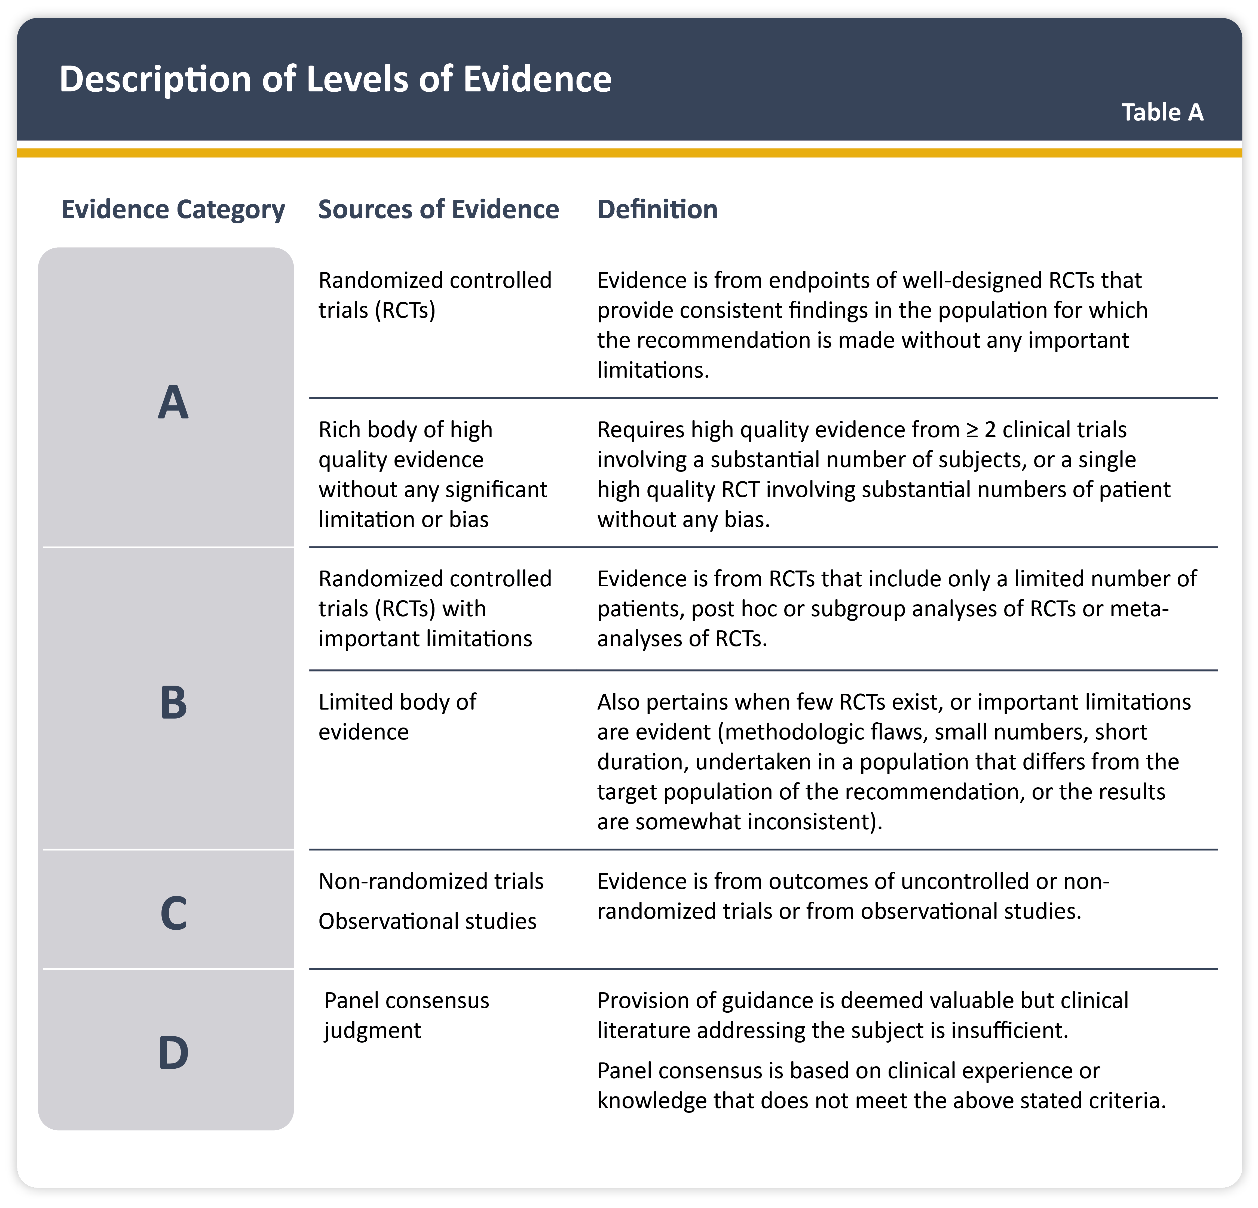
Teaching
Slide Set

Slide 3
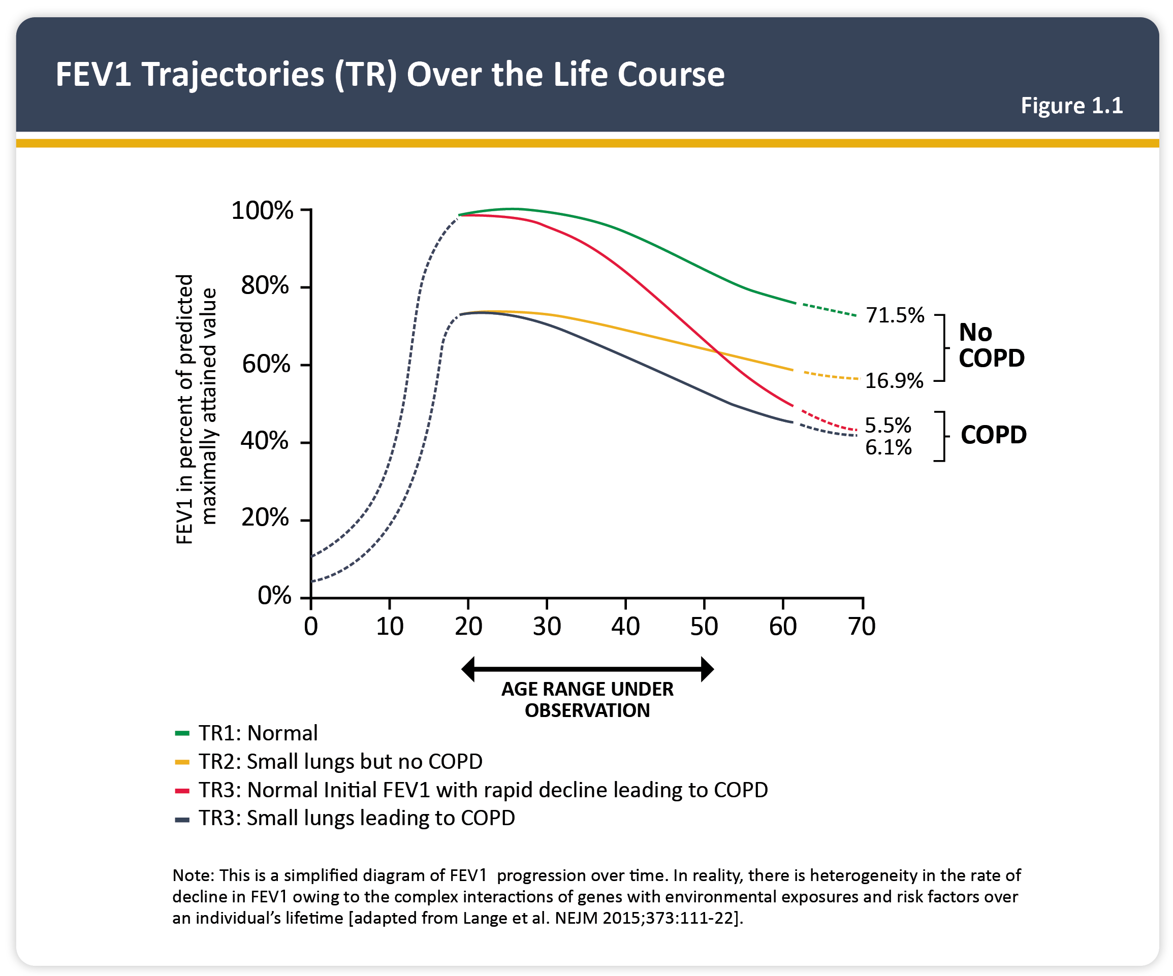
Teaching
Slide Set

Slide 4
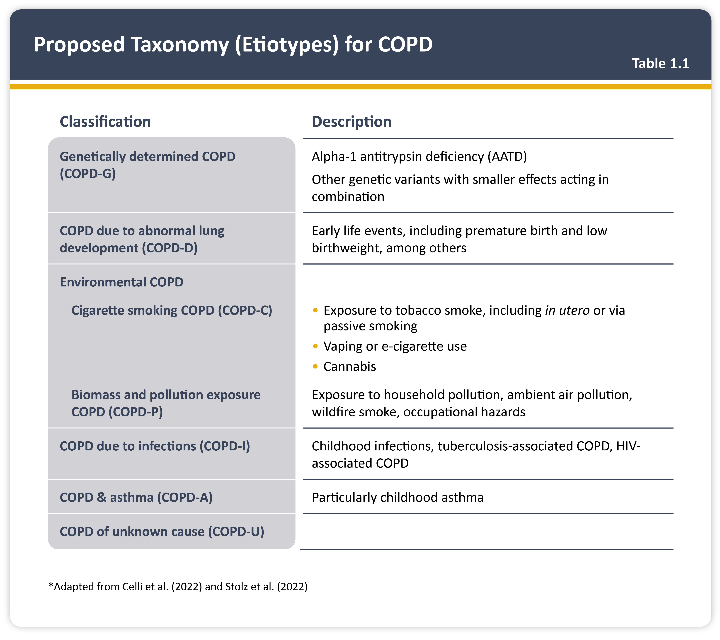
Teaching
Slide Set

Slide 5
Teaching
Slide Set

Slide 6
Teaching
Slide Set

Slide 7
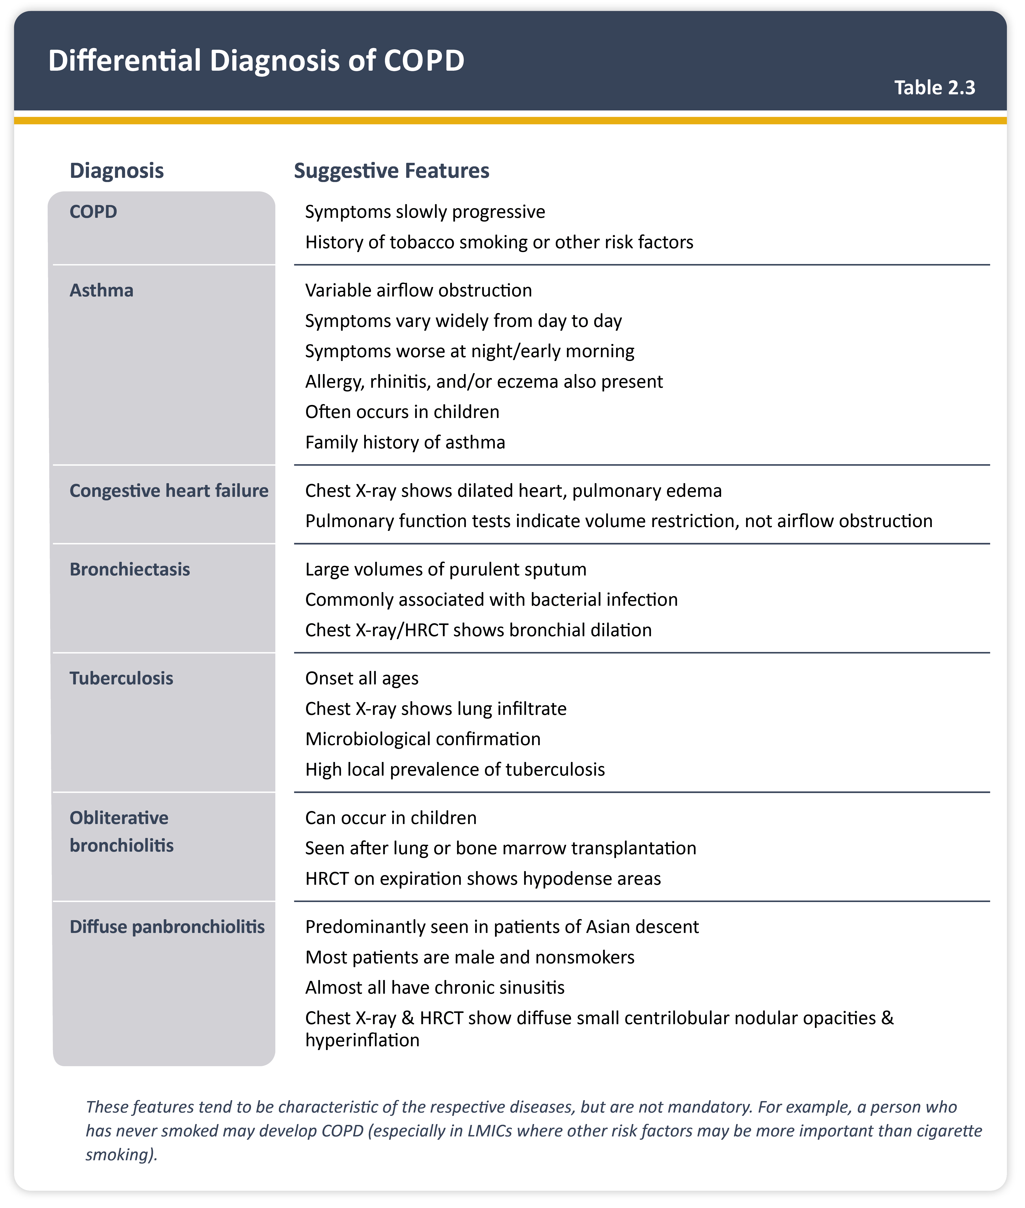
Teaching
Slide Set

Slide 8
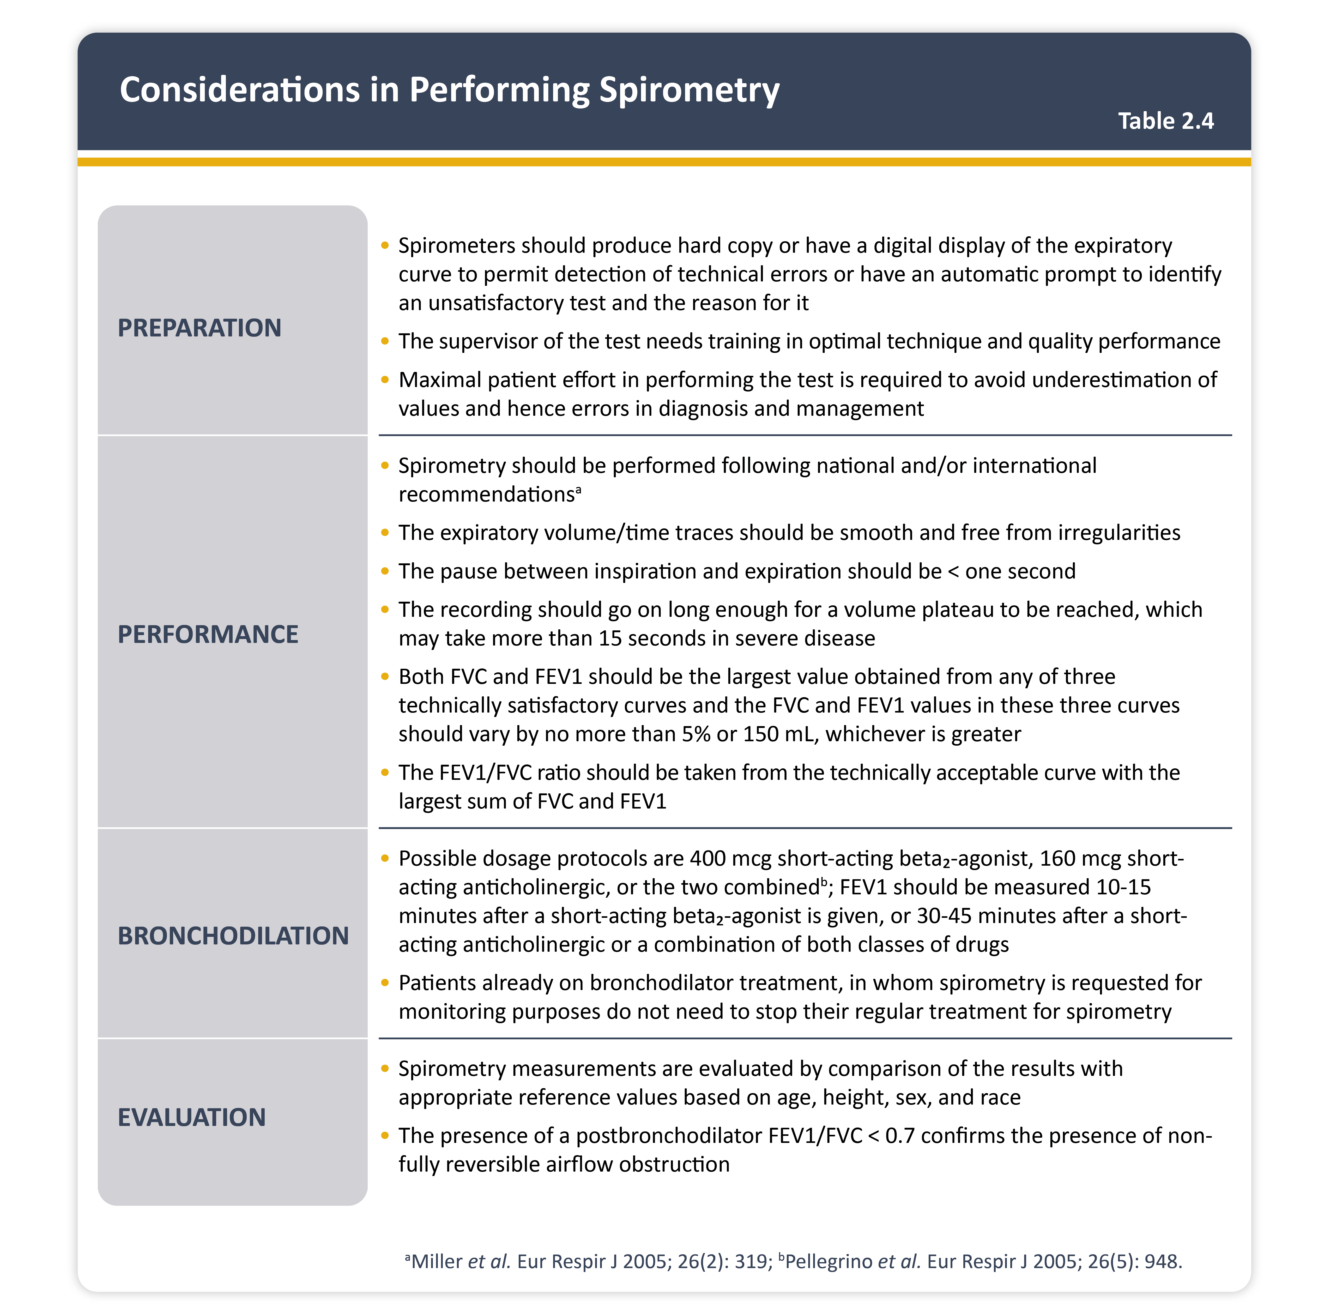
Teaching
Slide Set

Slide 9
Teaching
Slide Set

Slide 10
Teaching
Slide Set

Slide 11
Teaching
Slide Set

Slide 12
Teaching
Slide Set

Slide 13
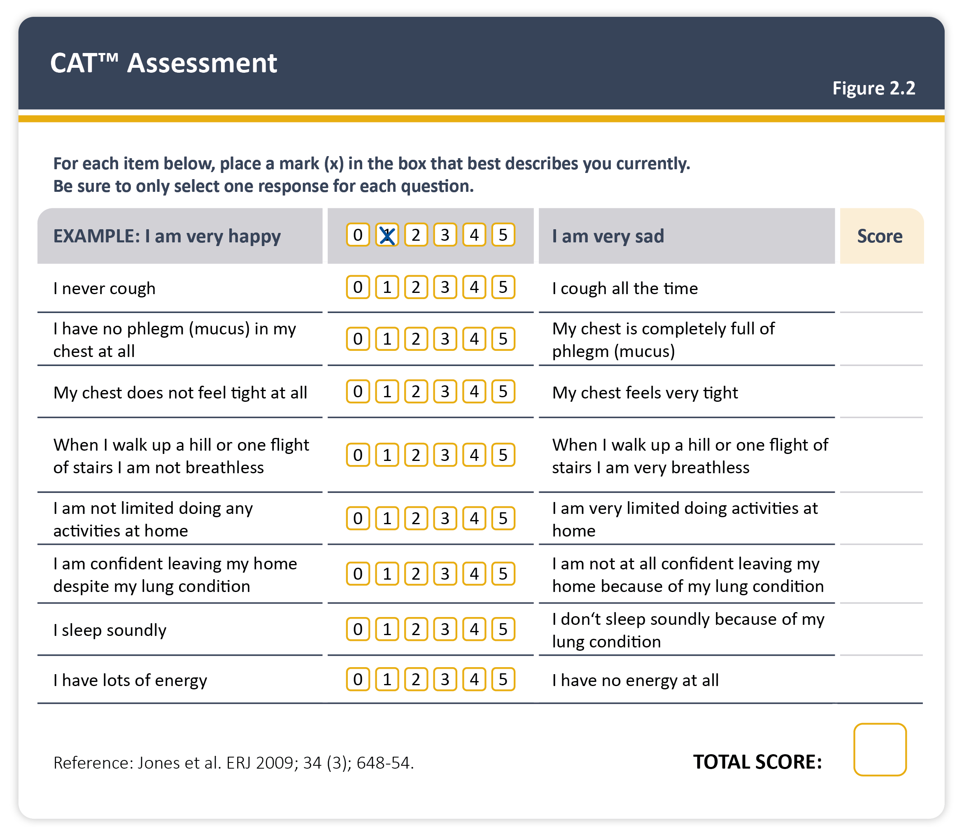
Teaching
Slide Set

Slide 14
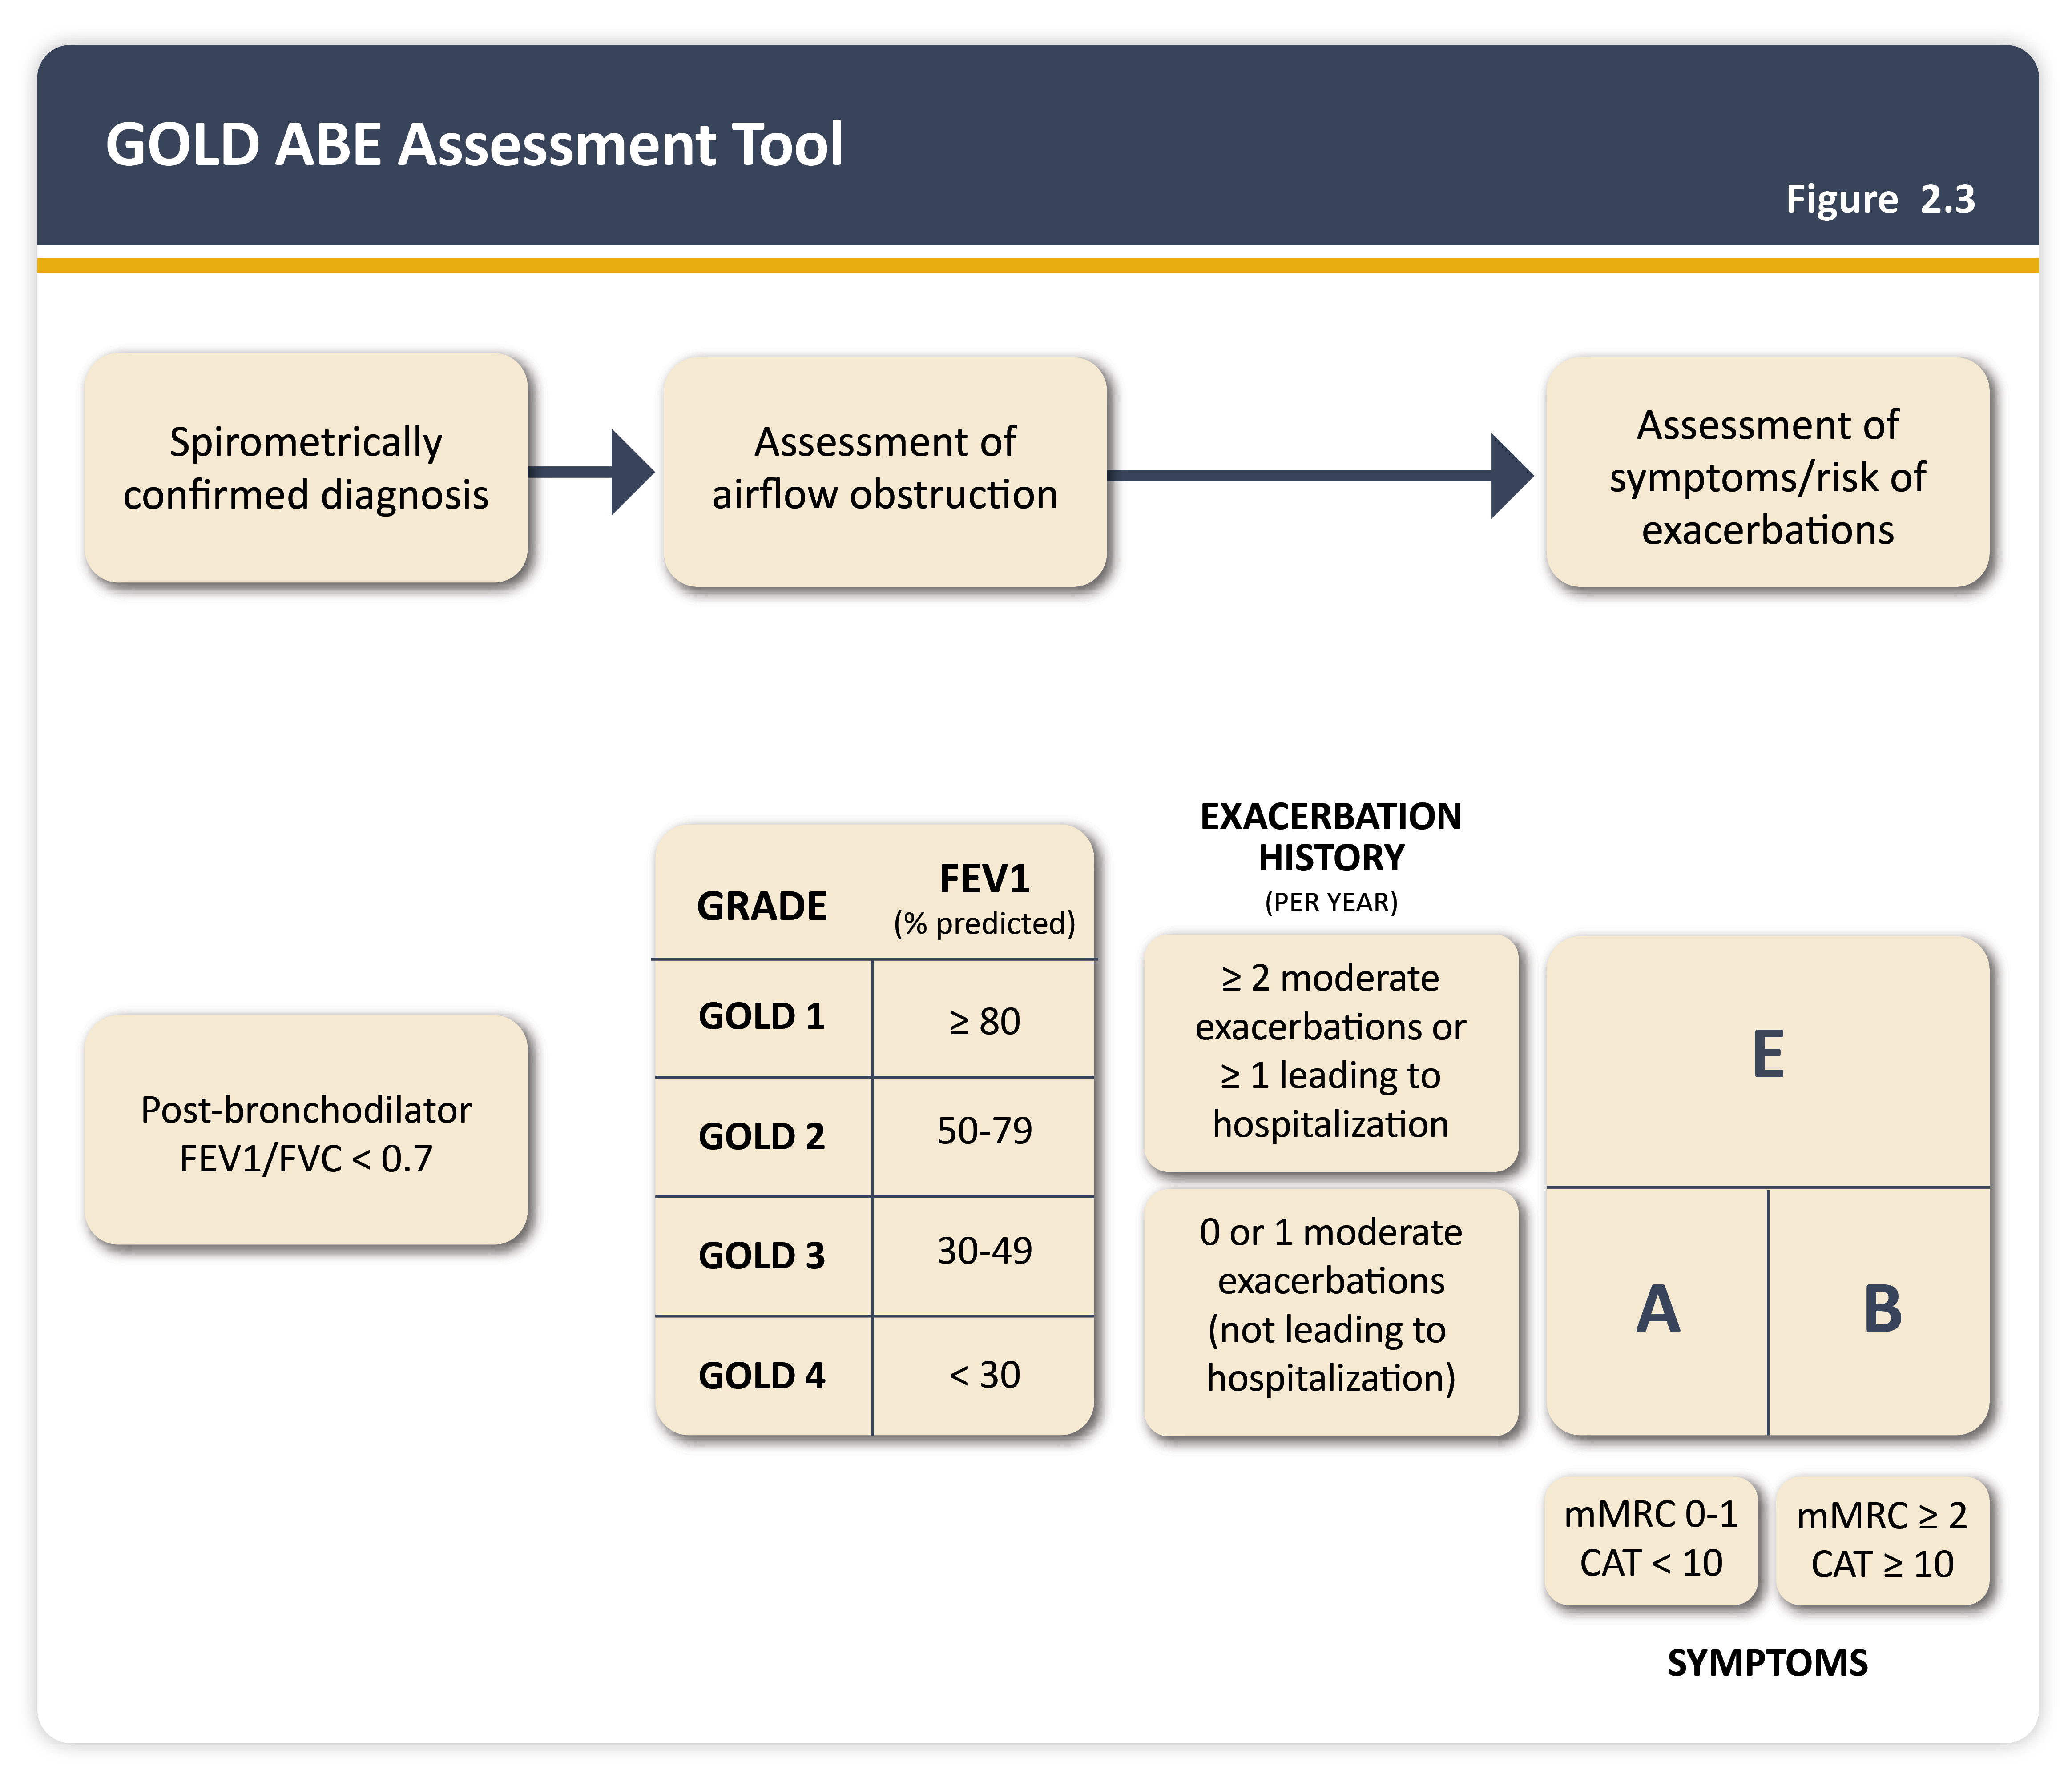
Teaching
Slide Set

Slide 15
Teaching
Slide Set

Slide 16
Teaching
Slide Set

Slide 17
Teaching
Slide Set

Slide 18
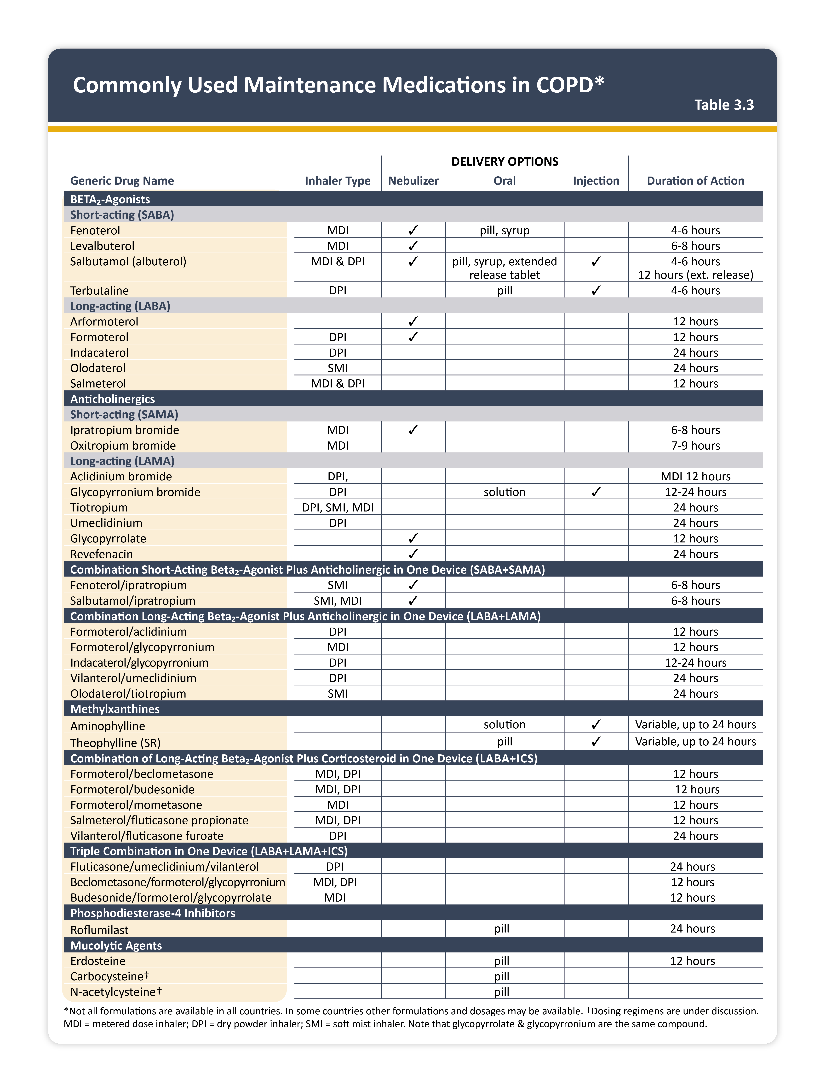
Teaching
Slide Set

Slide 19
Teaching
Slide Set

Slide 20
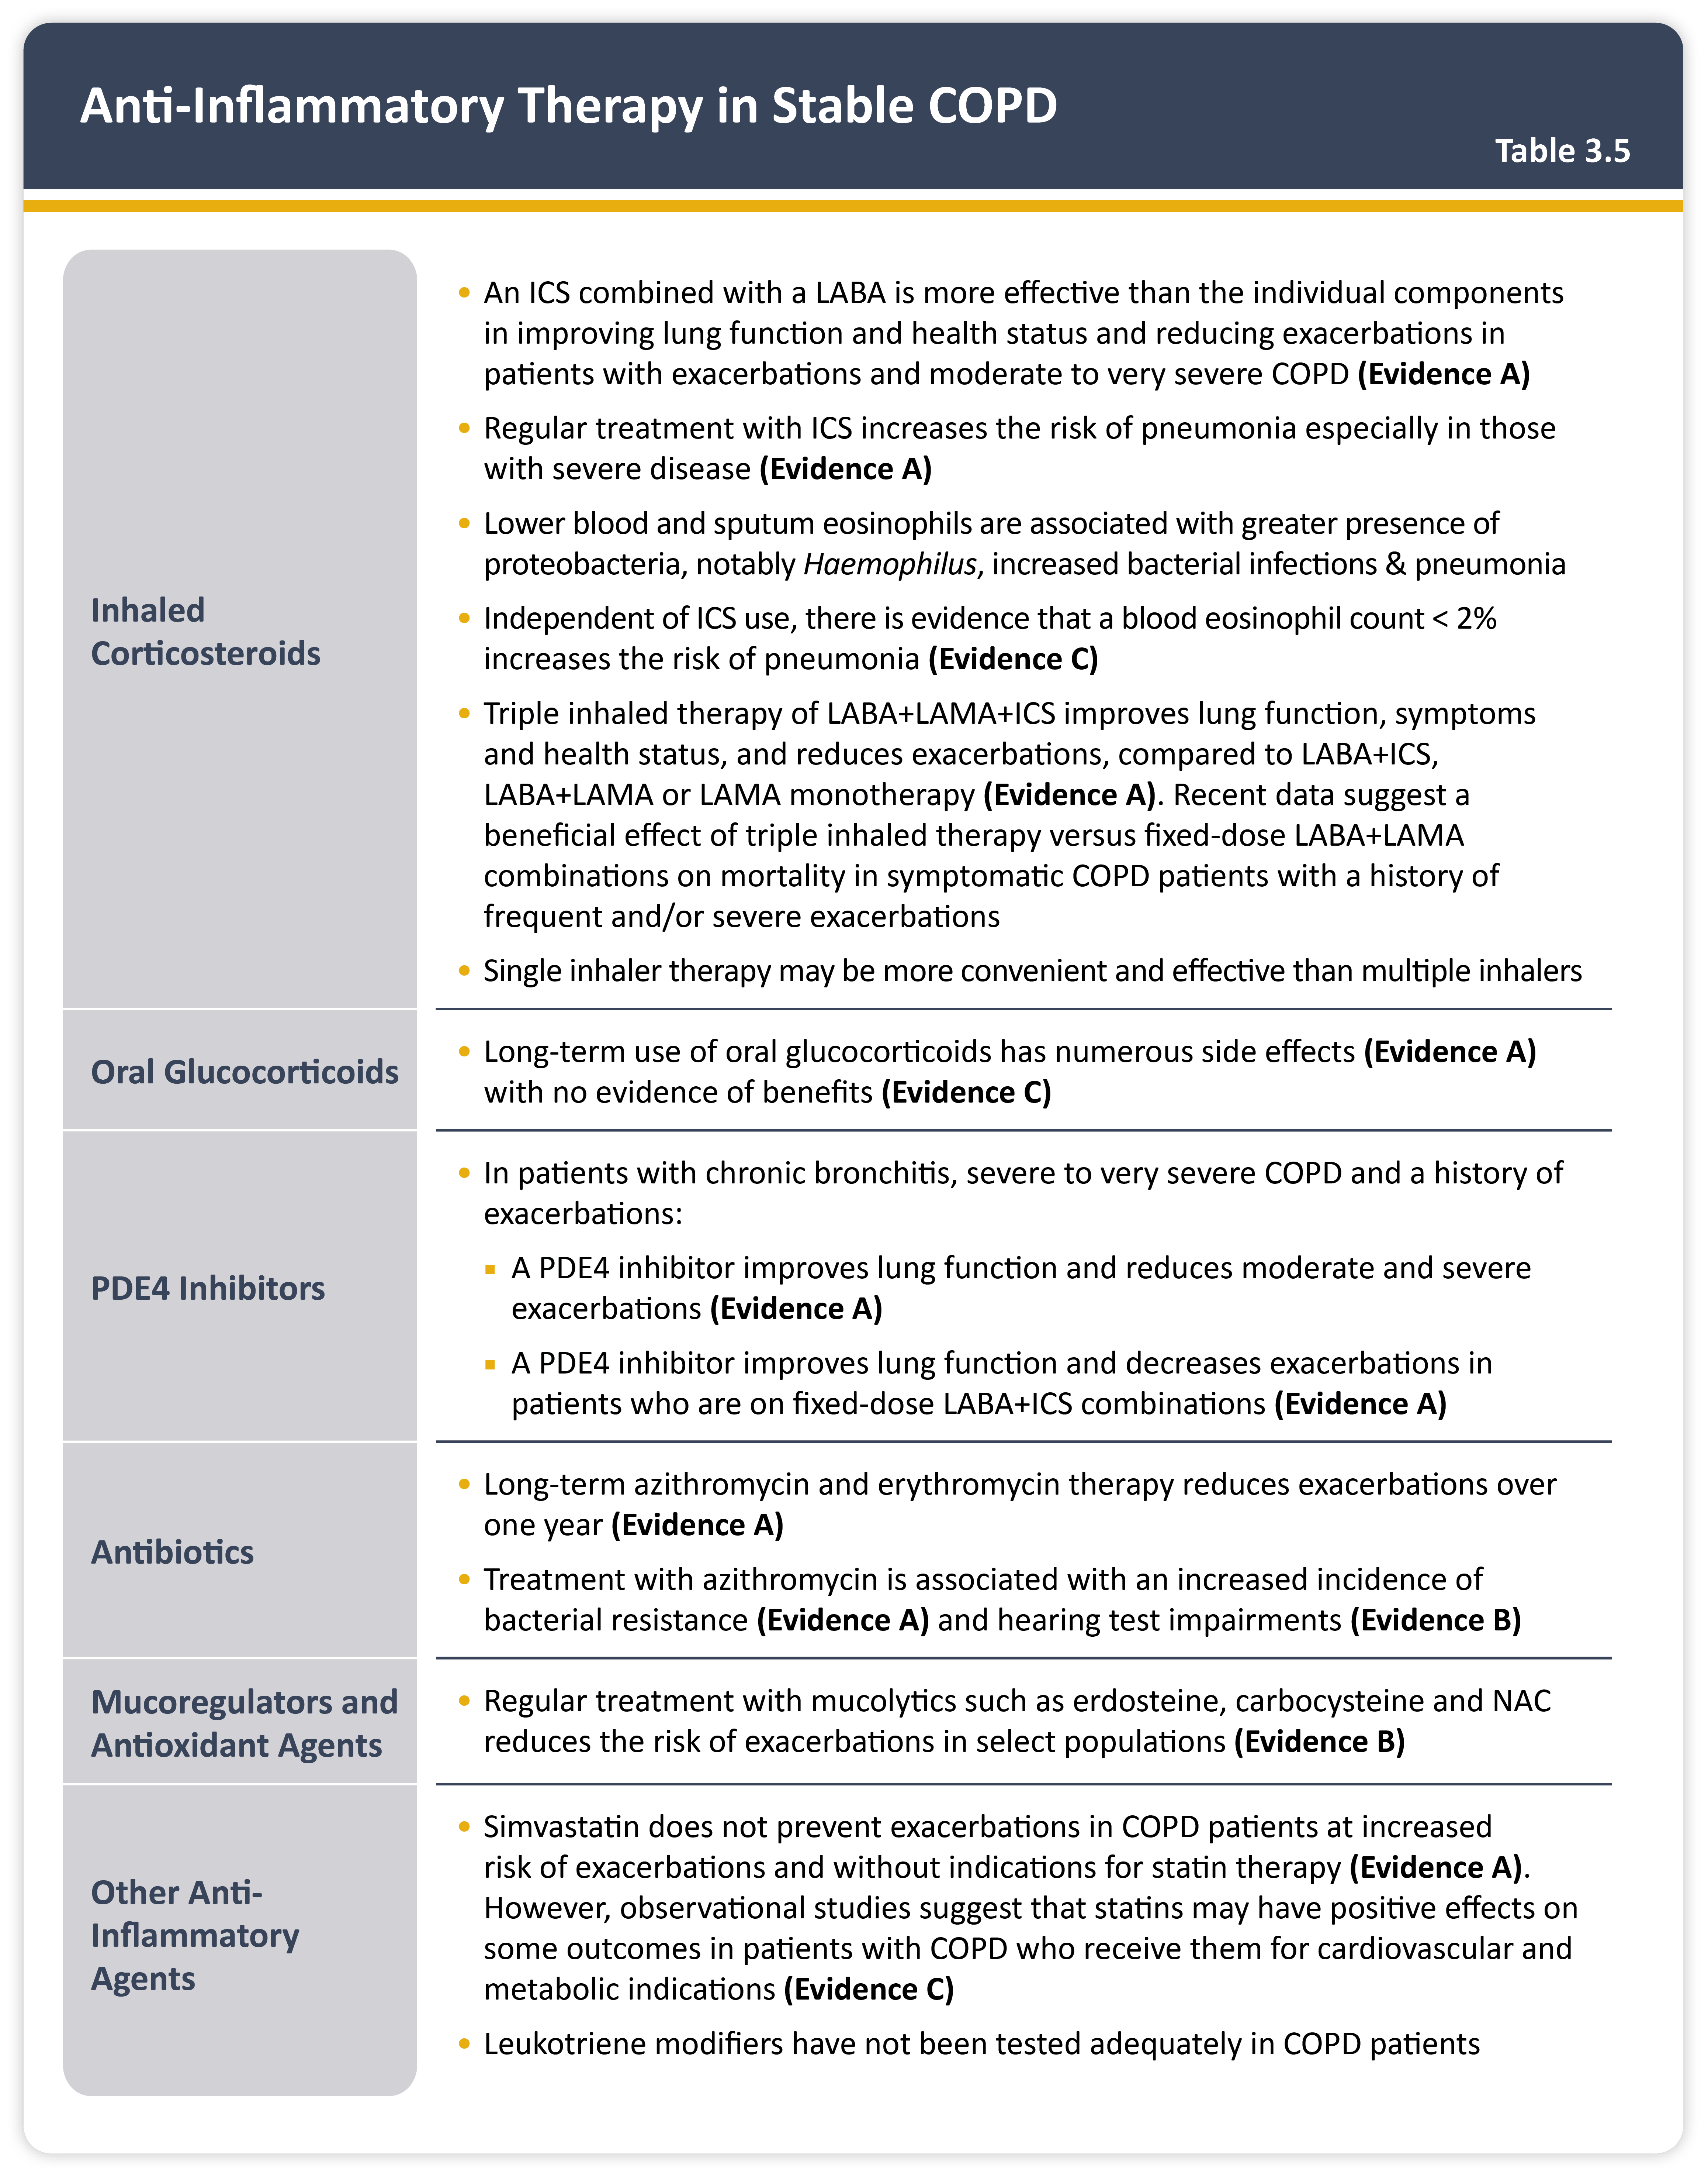
Teaching
Slide Set

Slide 21
Teaching
Slide Set

Slide 22
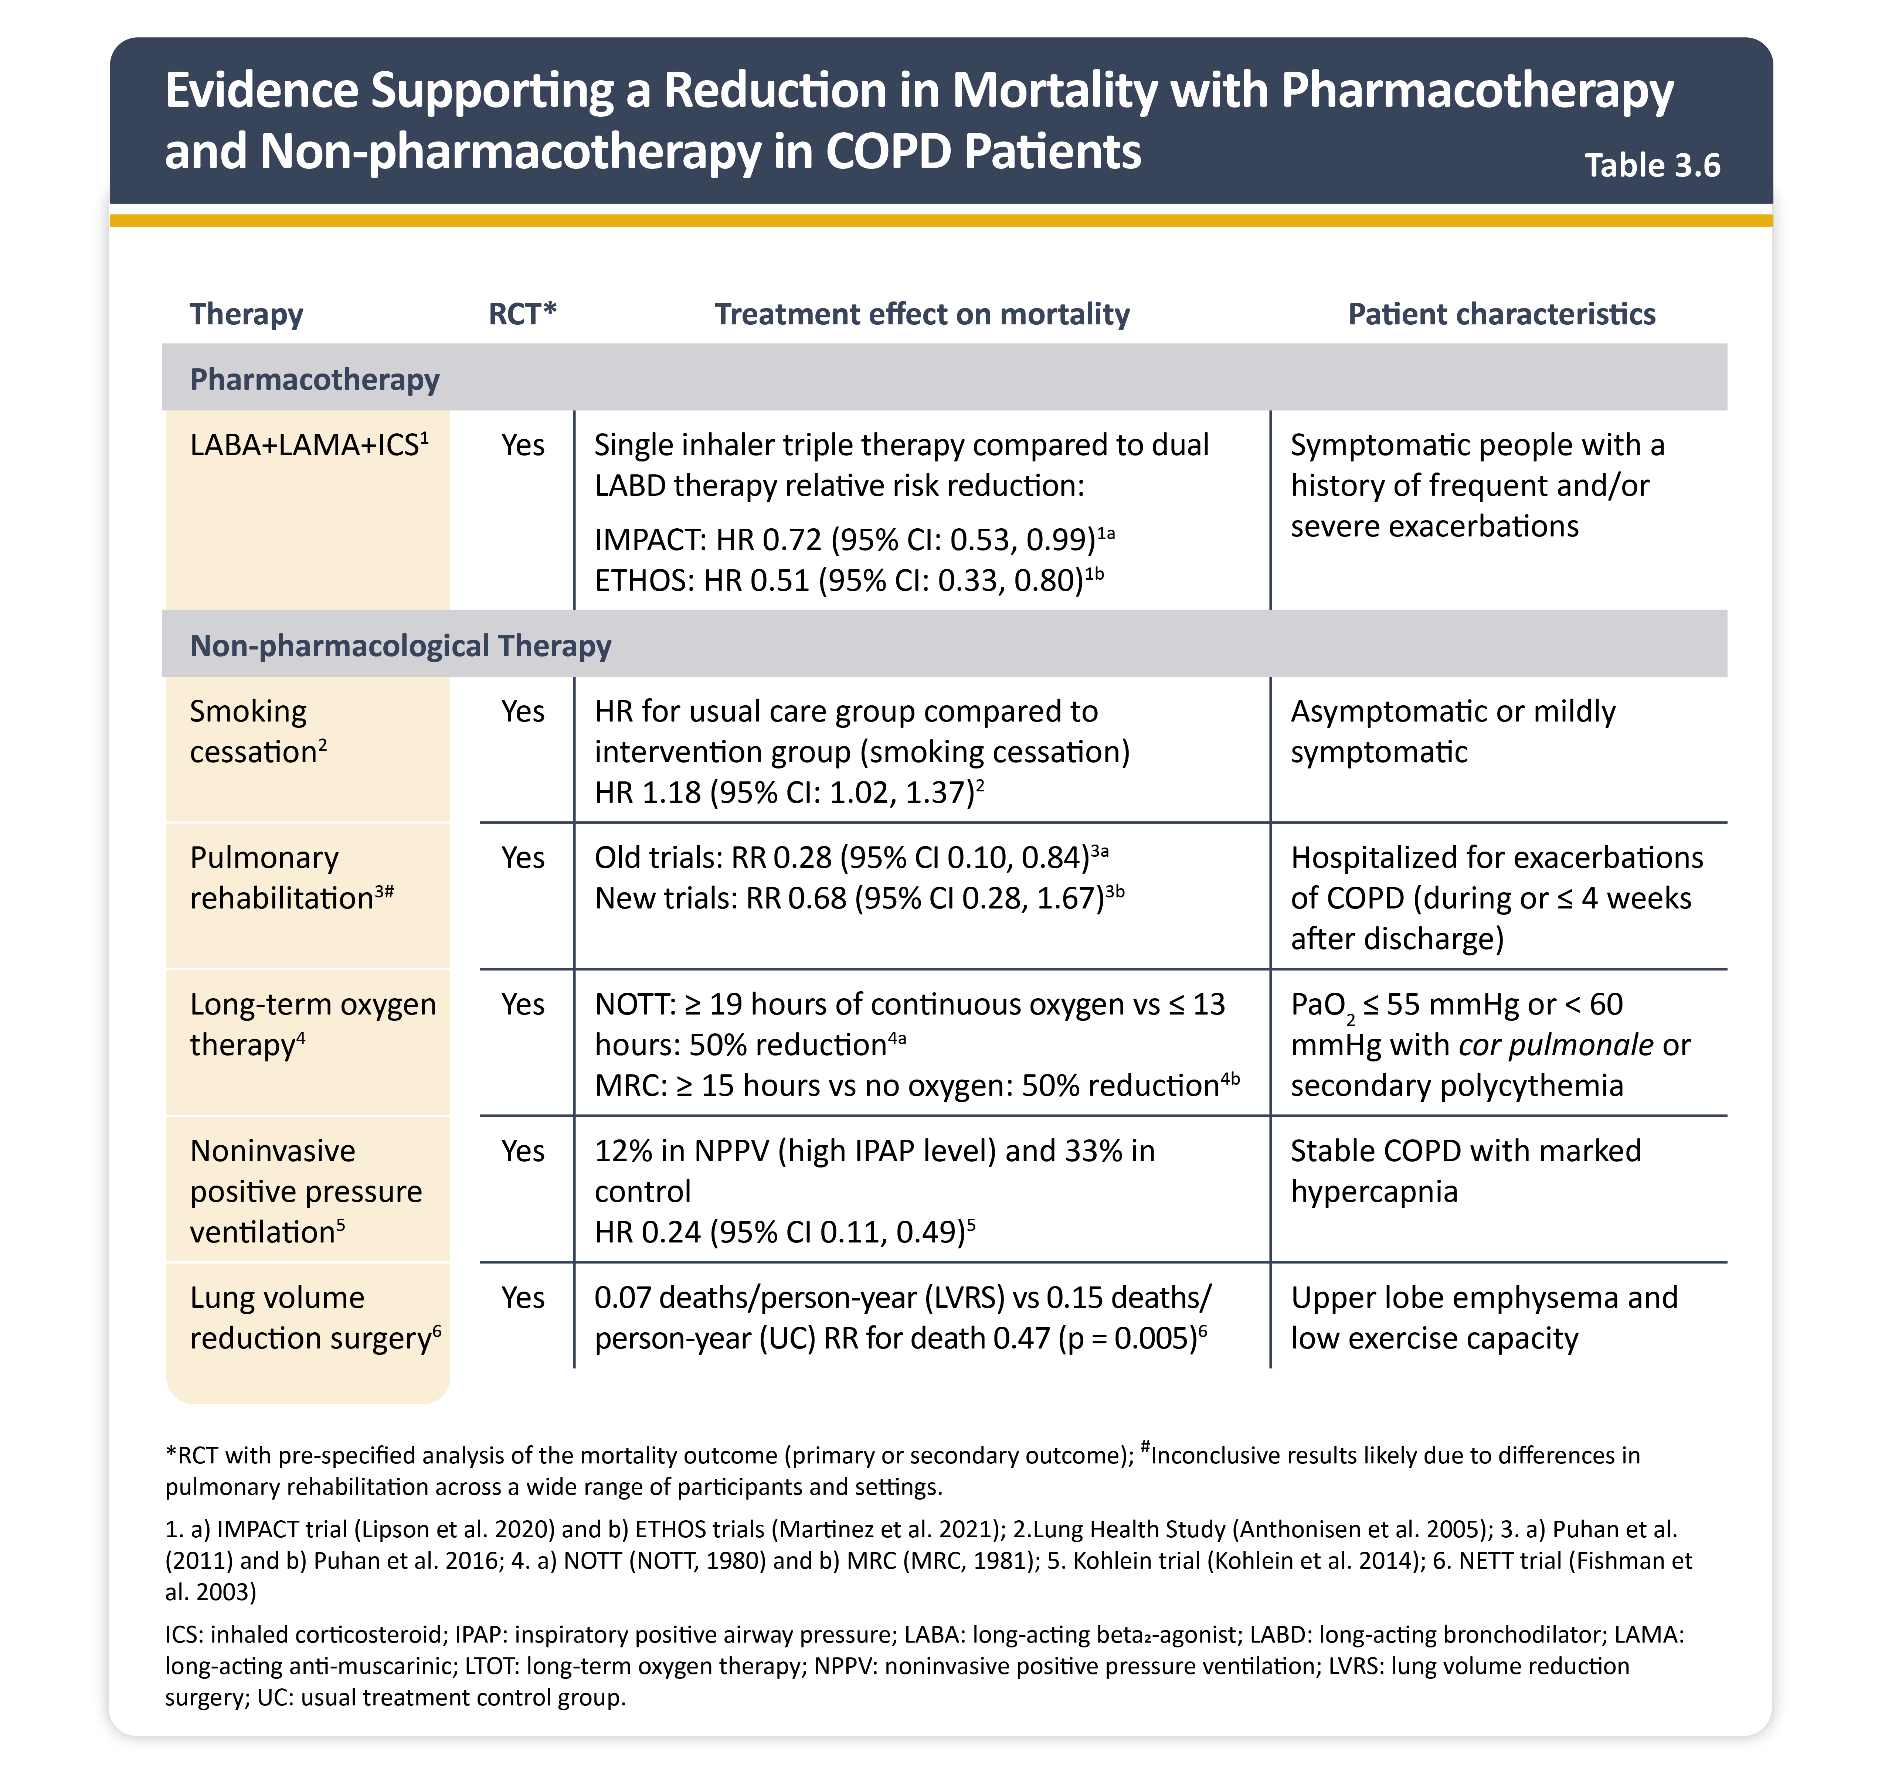
Teaching
Slide Set

Slide 23
Teaching
Slide Set

Slide 24
Teaching
Slide Set

Slide 25
Teaching
Slide Set

Slide 26
Teaching
Slide Set

Slide 27
Teaching
Slide Set

Slide 28
Teaching
Slide Set

Slide 29
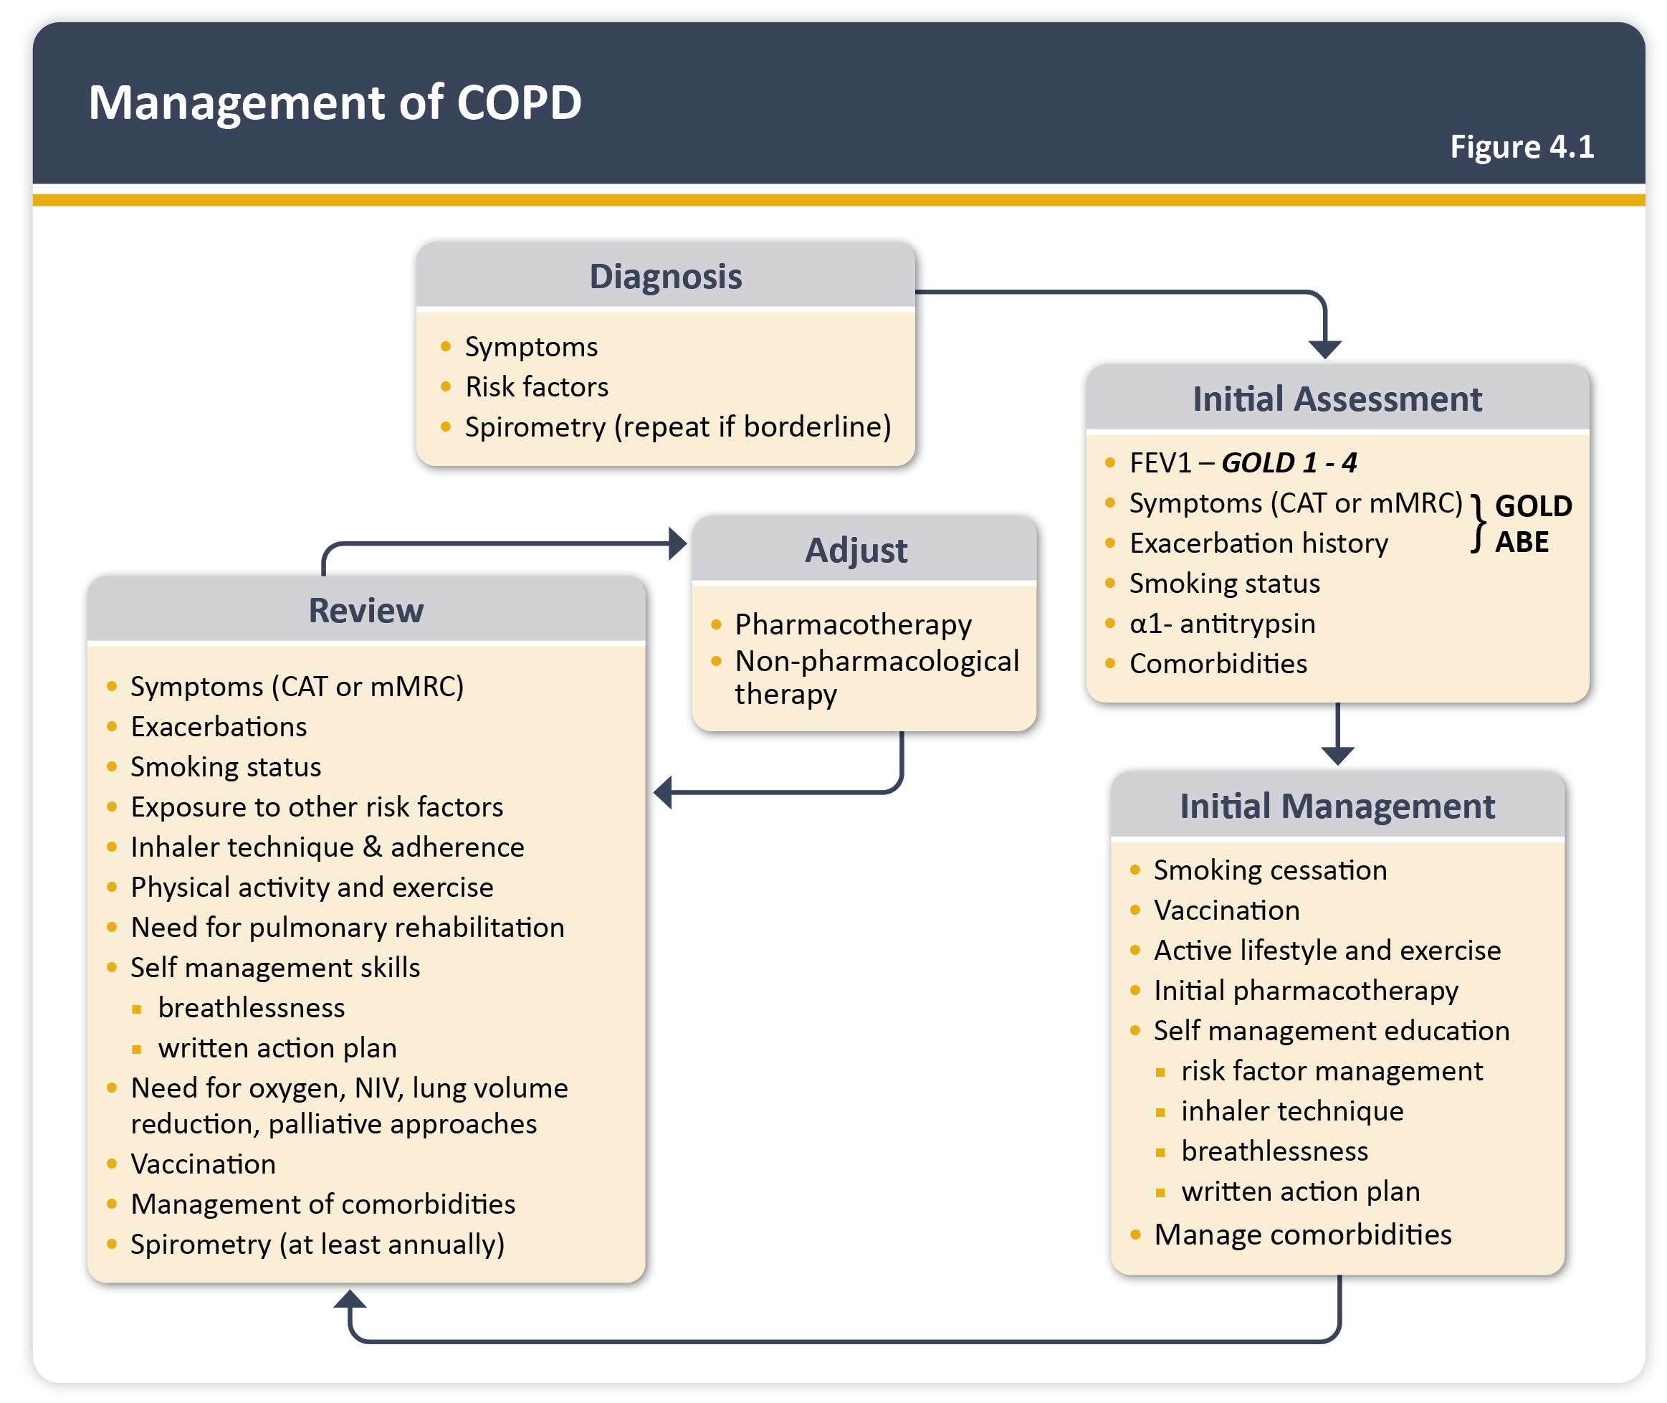
Teaching
Slide Set

Slide 30
Teaching
Slide Set

Slide 31
Teaching
Slide Set

Slide 32
Teaching
Slide Set

Slide 33
Teaching
Slide Set

Slide 34
Teaching
Slide Set

Slide 35
Teaching
Slide Set

Slide 36
Teaching
Slide Set

Slide 37
Teaching
Slide Set

Slide 38
Teaching
Slide Set

Slide 39
Teaching
Slide Set

Slide 40
Teaching
Slide Set

Slide 41
Teaching
Slide Set

Slide 42
Teaching
Slide Set

Slide 43
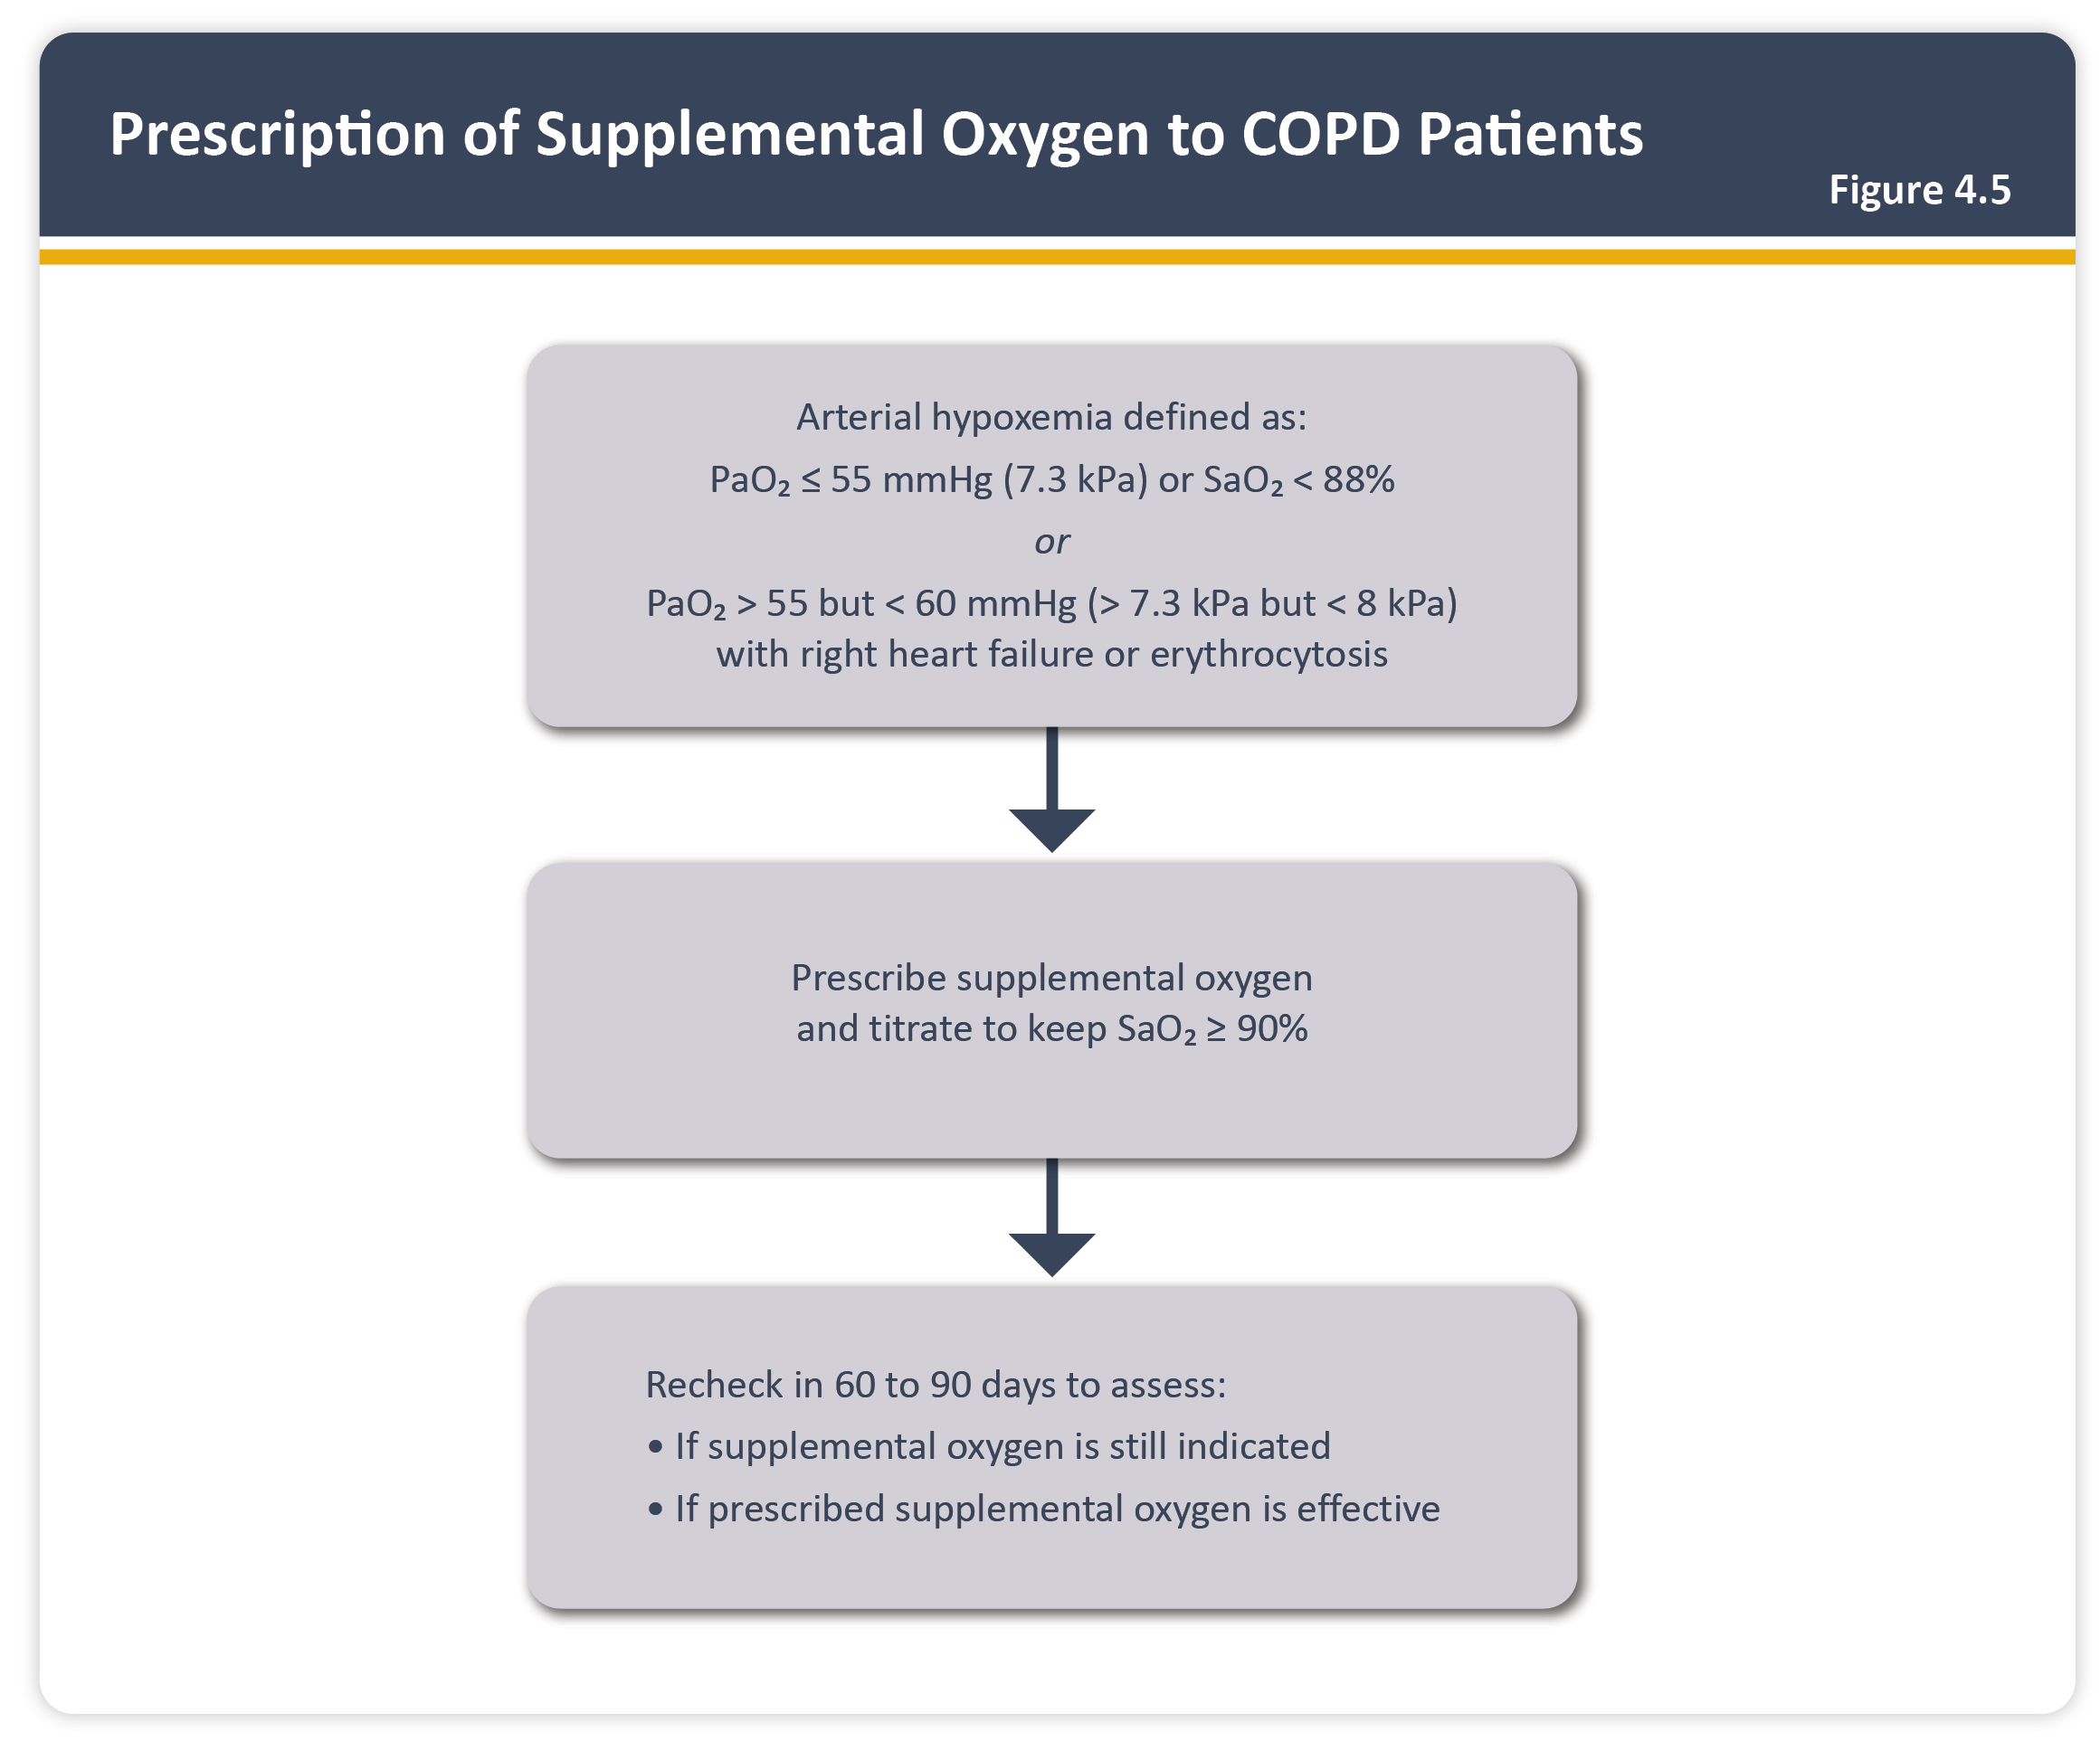
Teaching
Slide Set

Slide 44
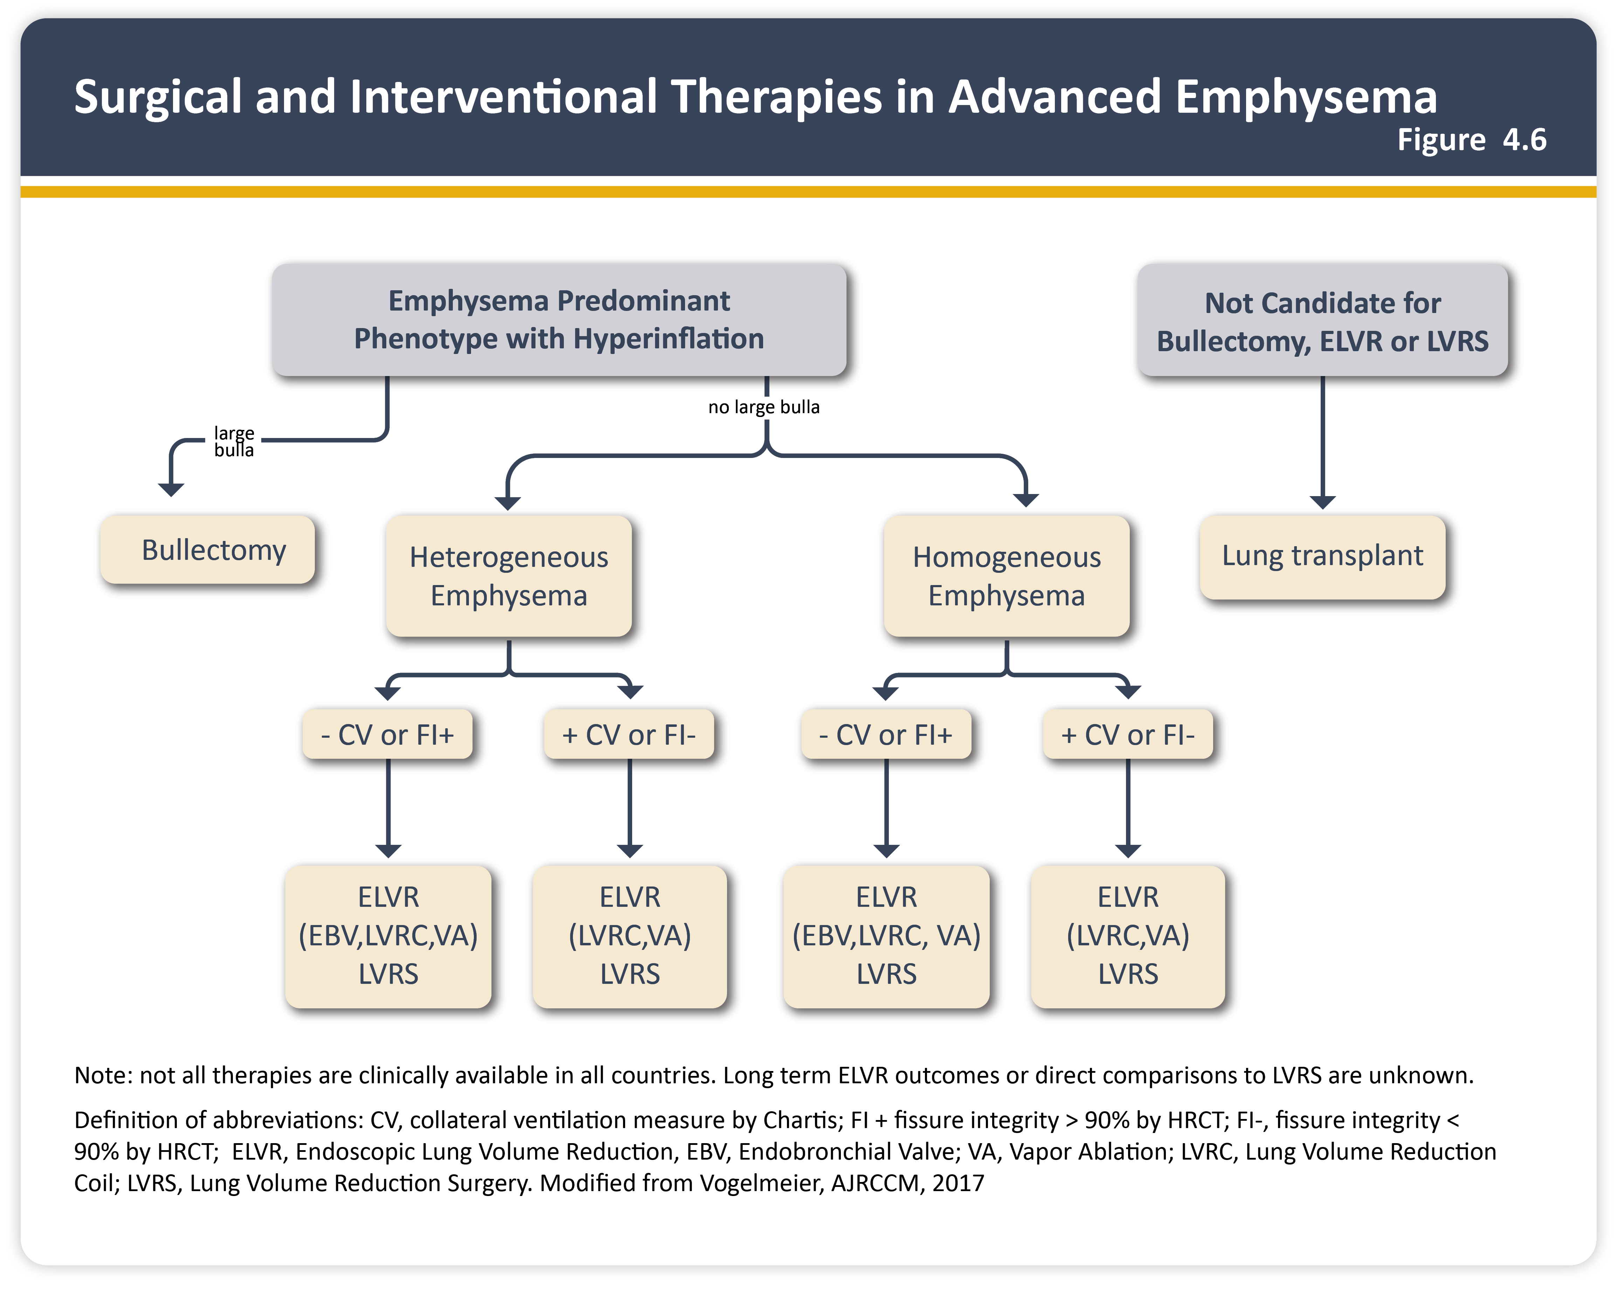
Teaching
Slide Set

Slide 45
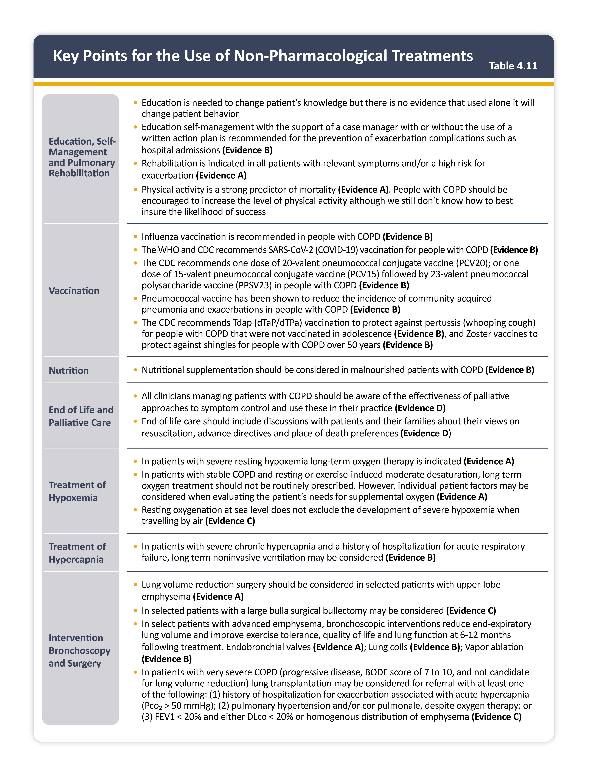
Teaching
Slide Set

Slide 46
Teaching
Slide Set

Slide 47
Teaching
Slide Set

Slide 48
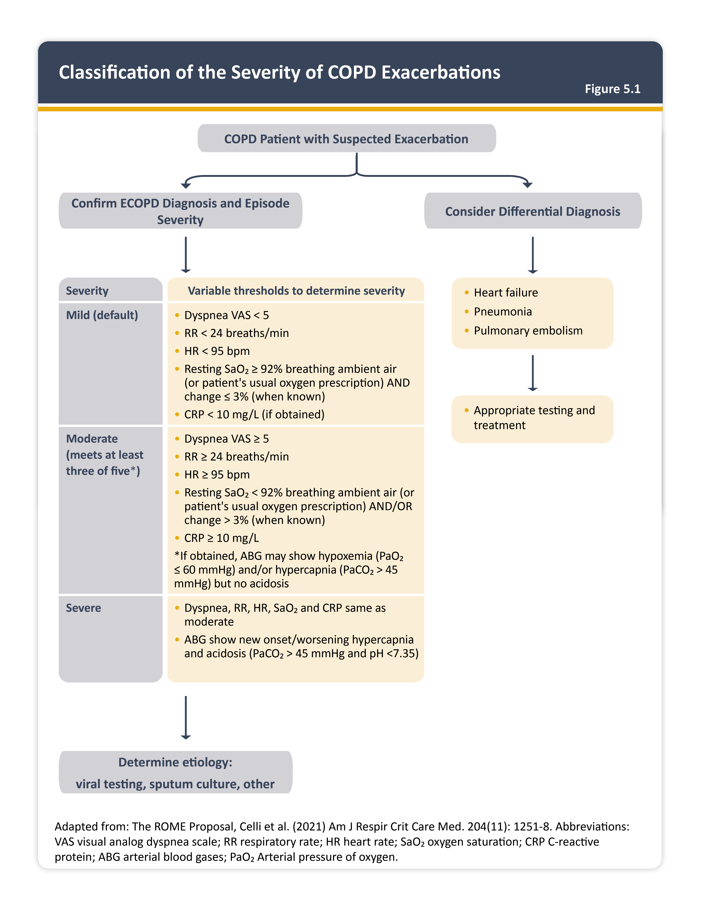
Teaching
Slide Set

Slide 49
Teaching
Slide Set

Slide 50
Teaching
Slide Set

Slide 51
Teaching
Slide Set

Slide 52
Teaching
Slide Set

Slide 53
Teaching
Slide Set

Slide 54
Teaching
Slide Set

Slide 55
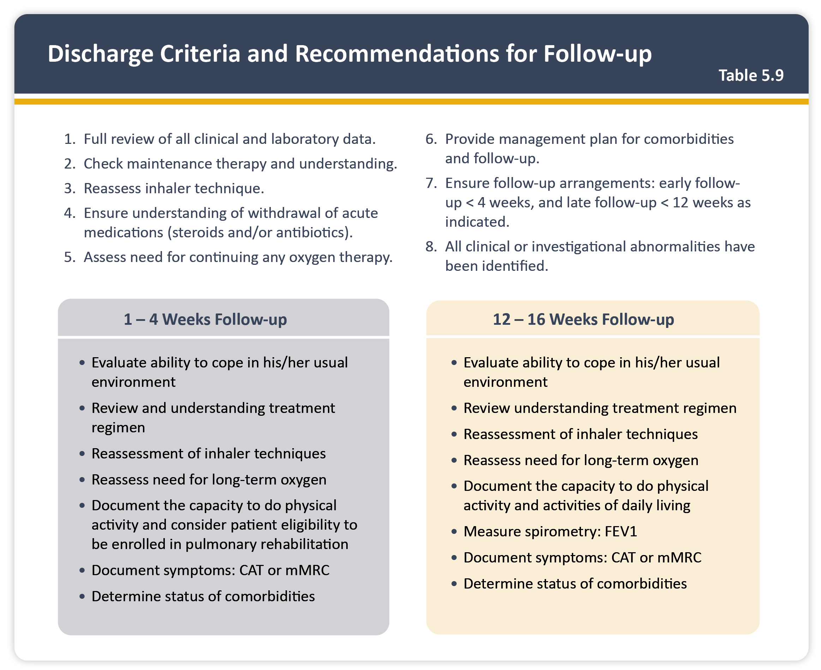
Teaching
Slide Set

Slide 56
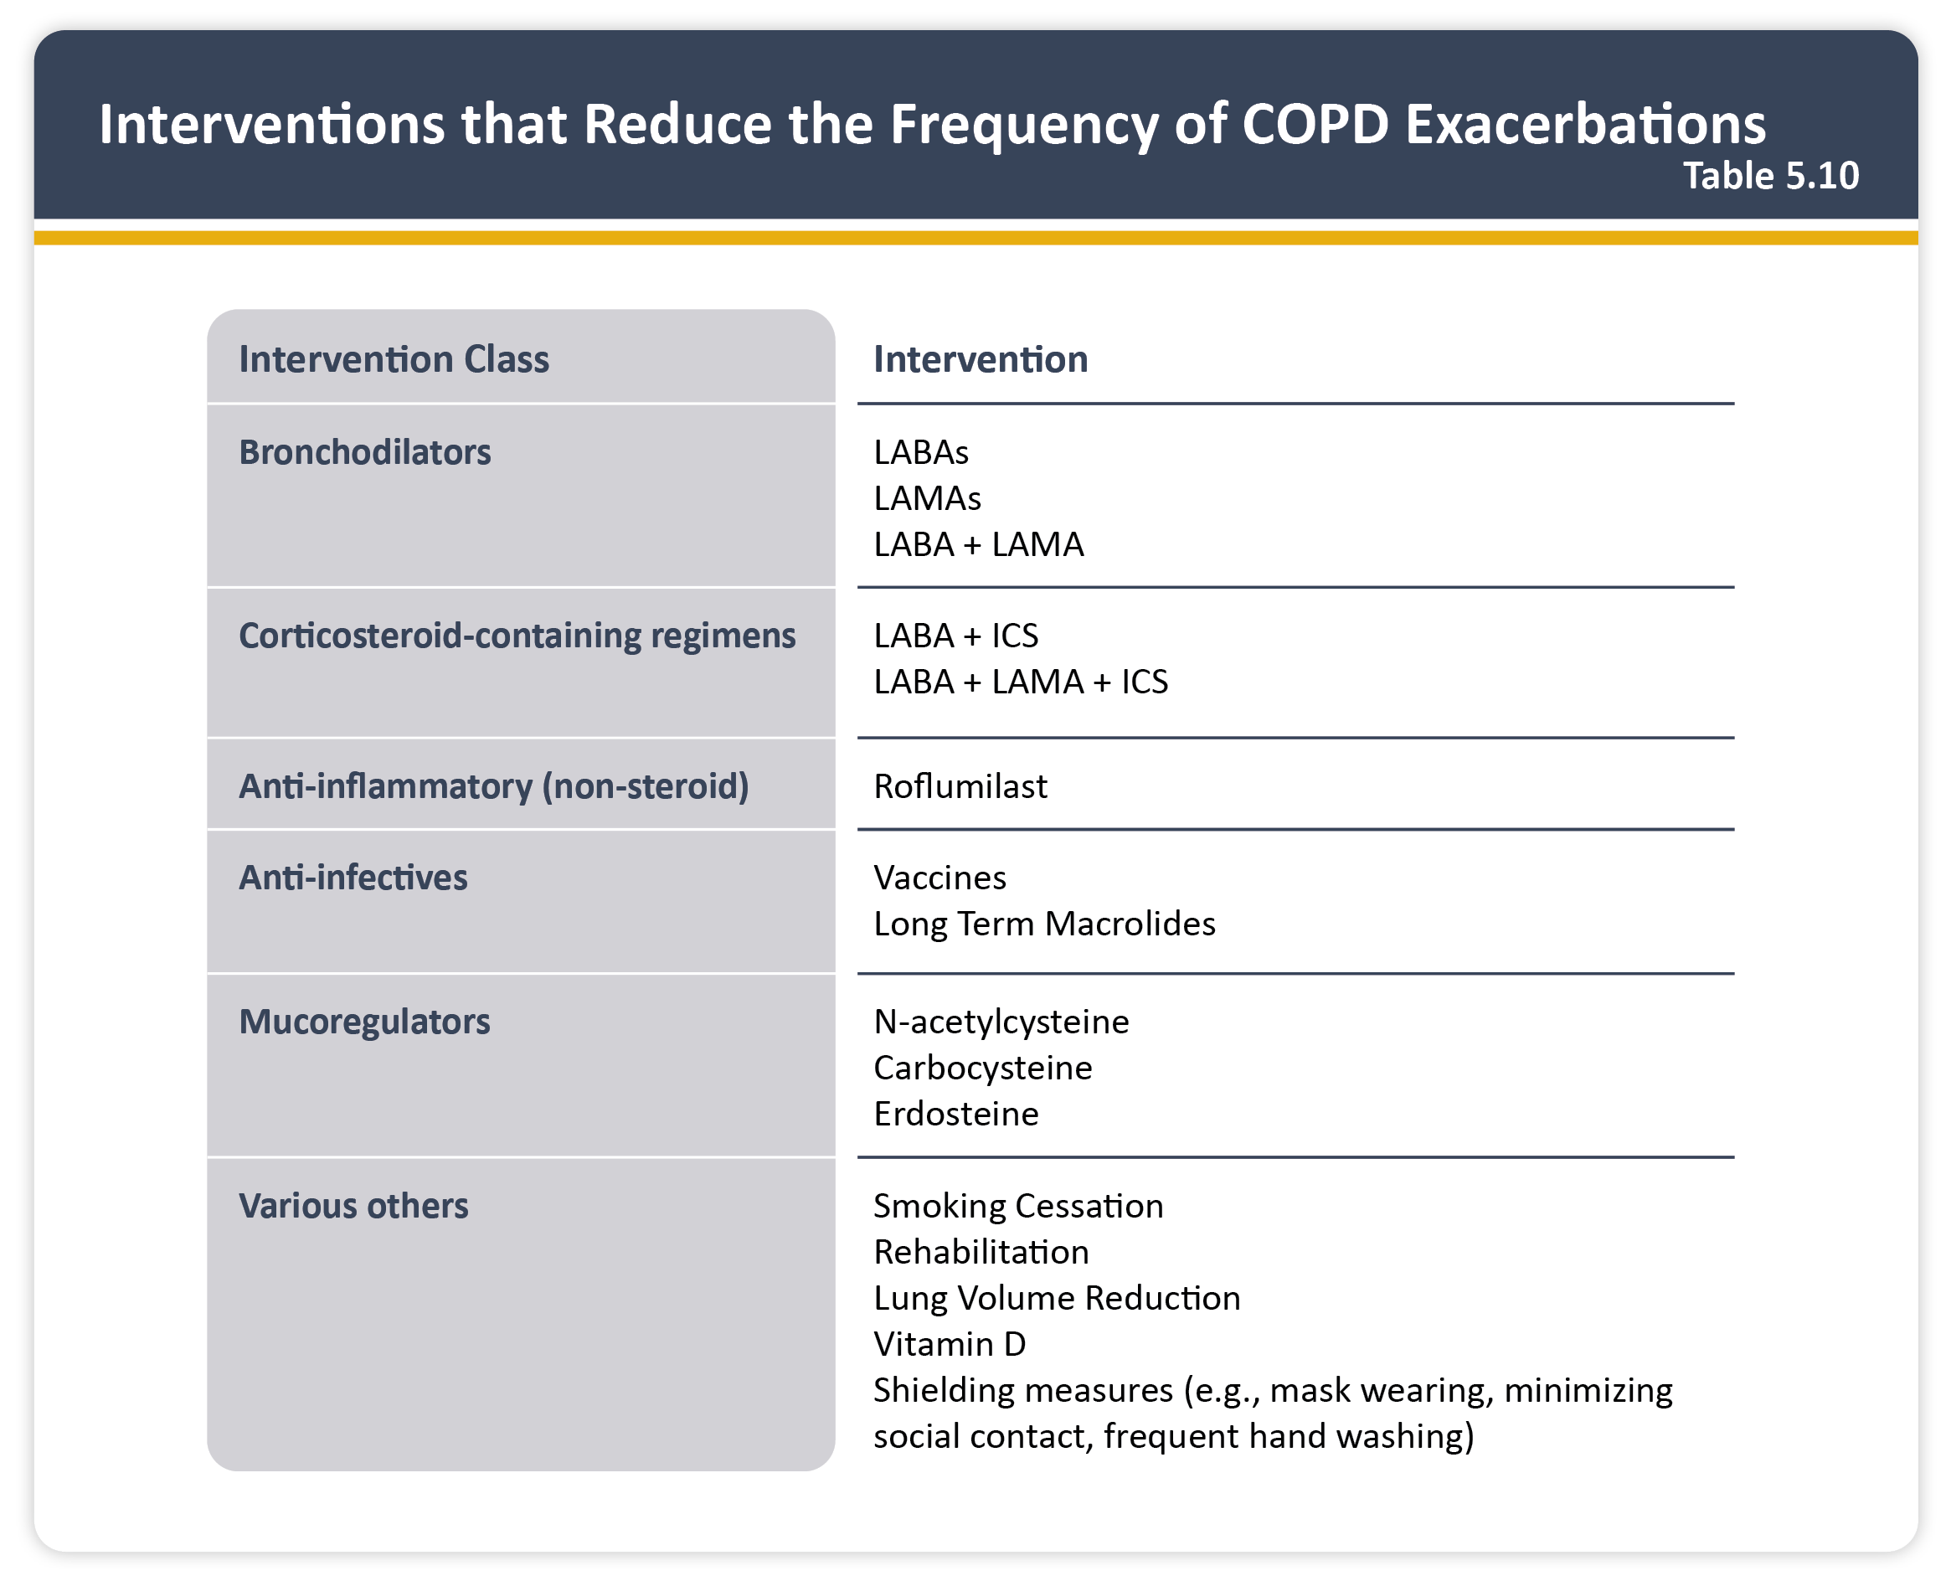
Teaching
Slide Set

Slide 57
Teaching
Slide Set

Slide 58
Teaching
Slide Set

Slide 59
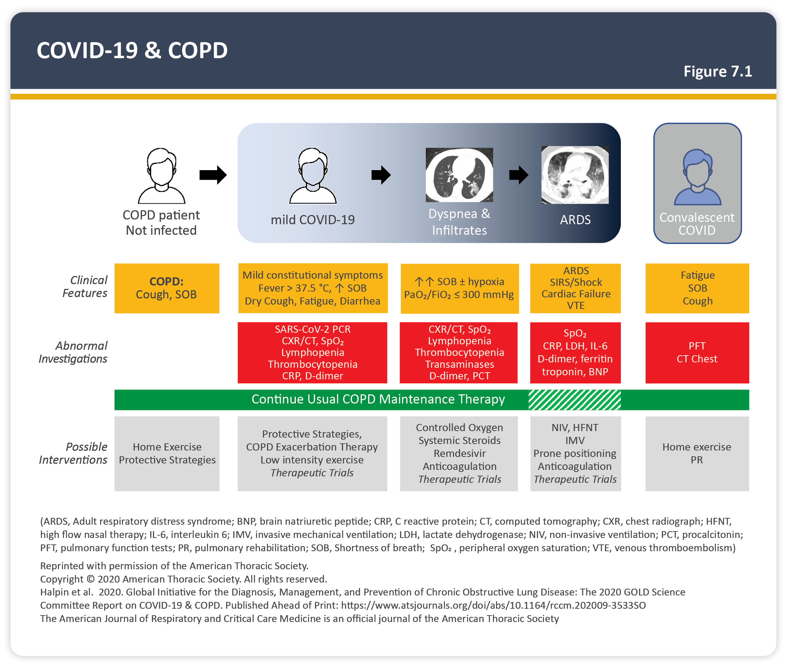
Teaching
Slide Set

Slide 60
Teaching
Slide Set

Slide 61
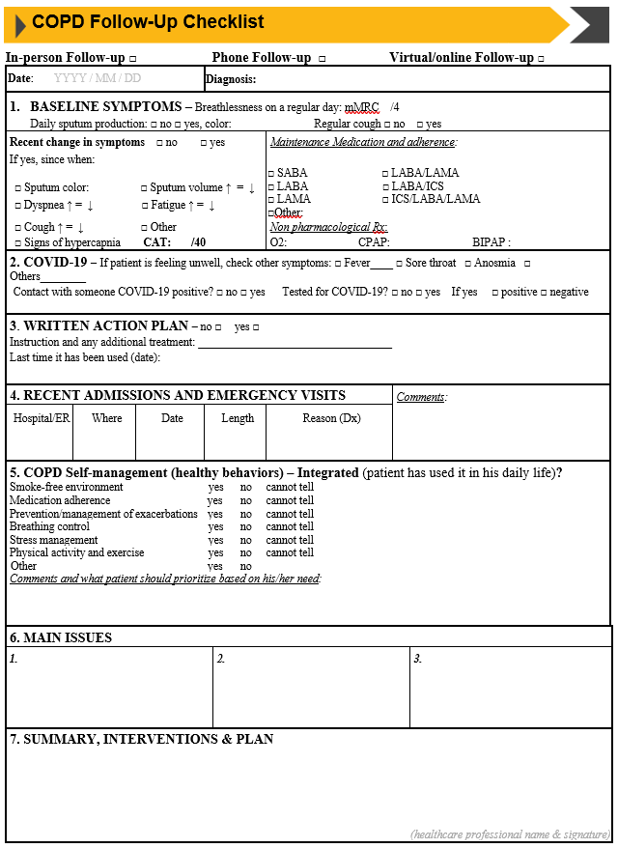
Teaching
Slide Set

